Slide 1
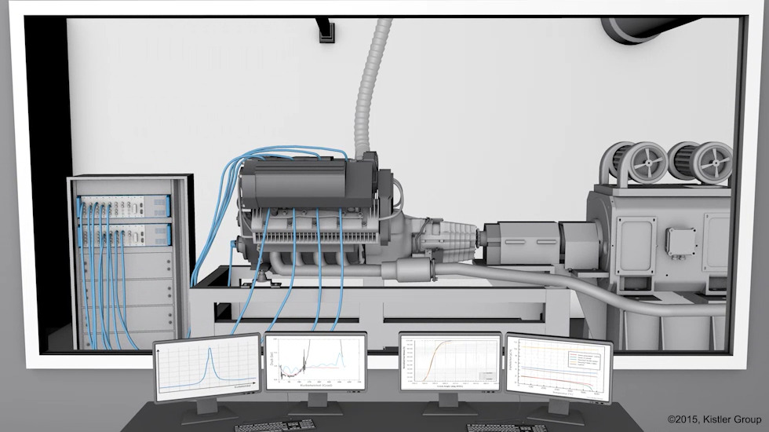
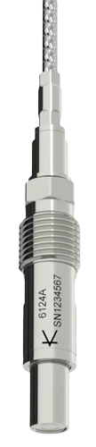
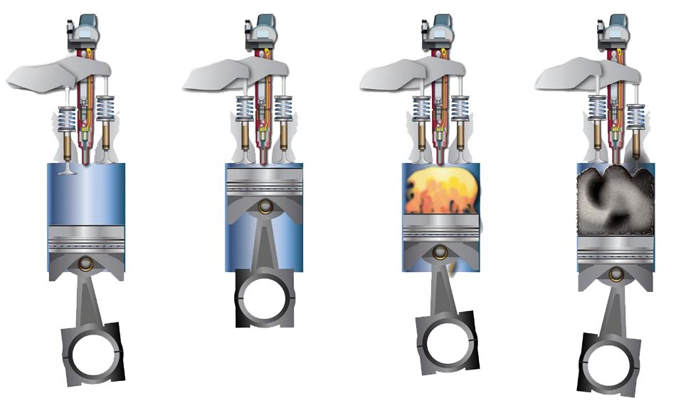
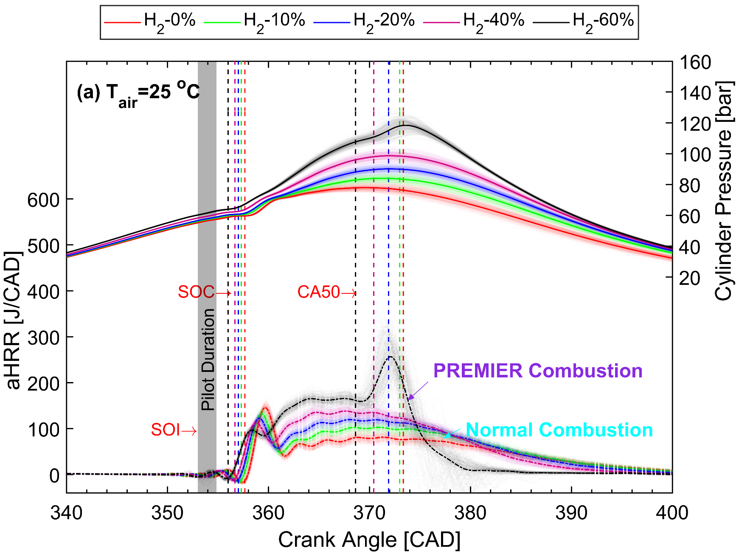
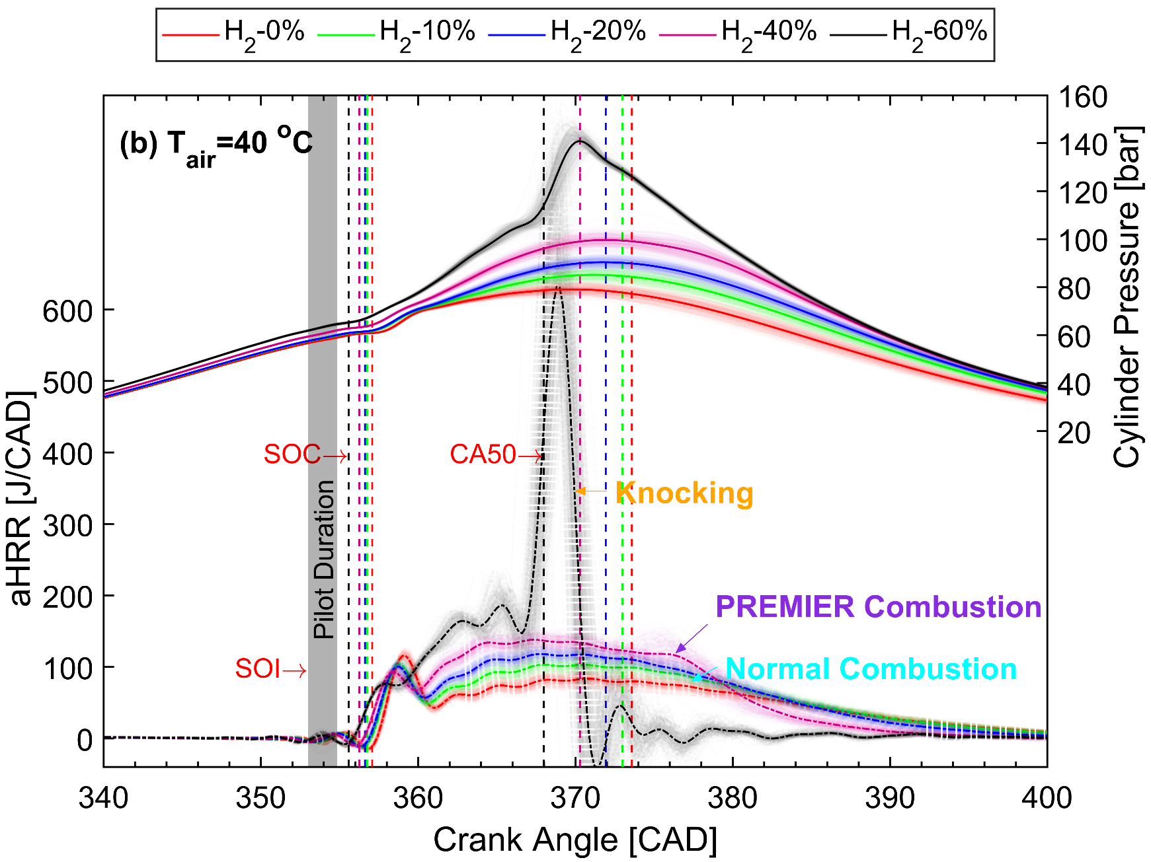
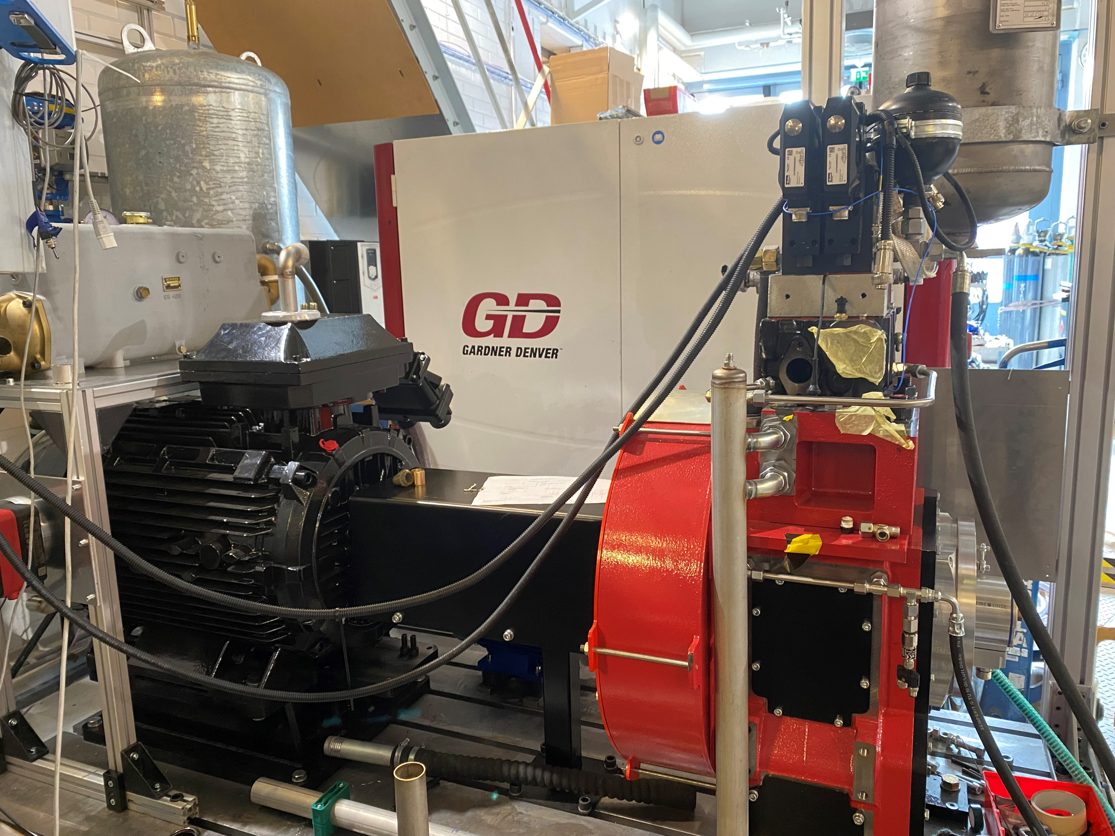
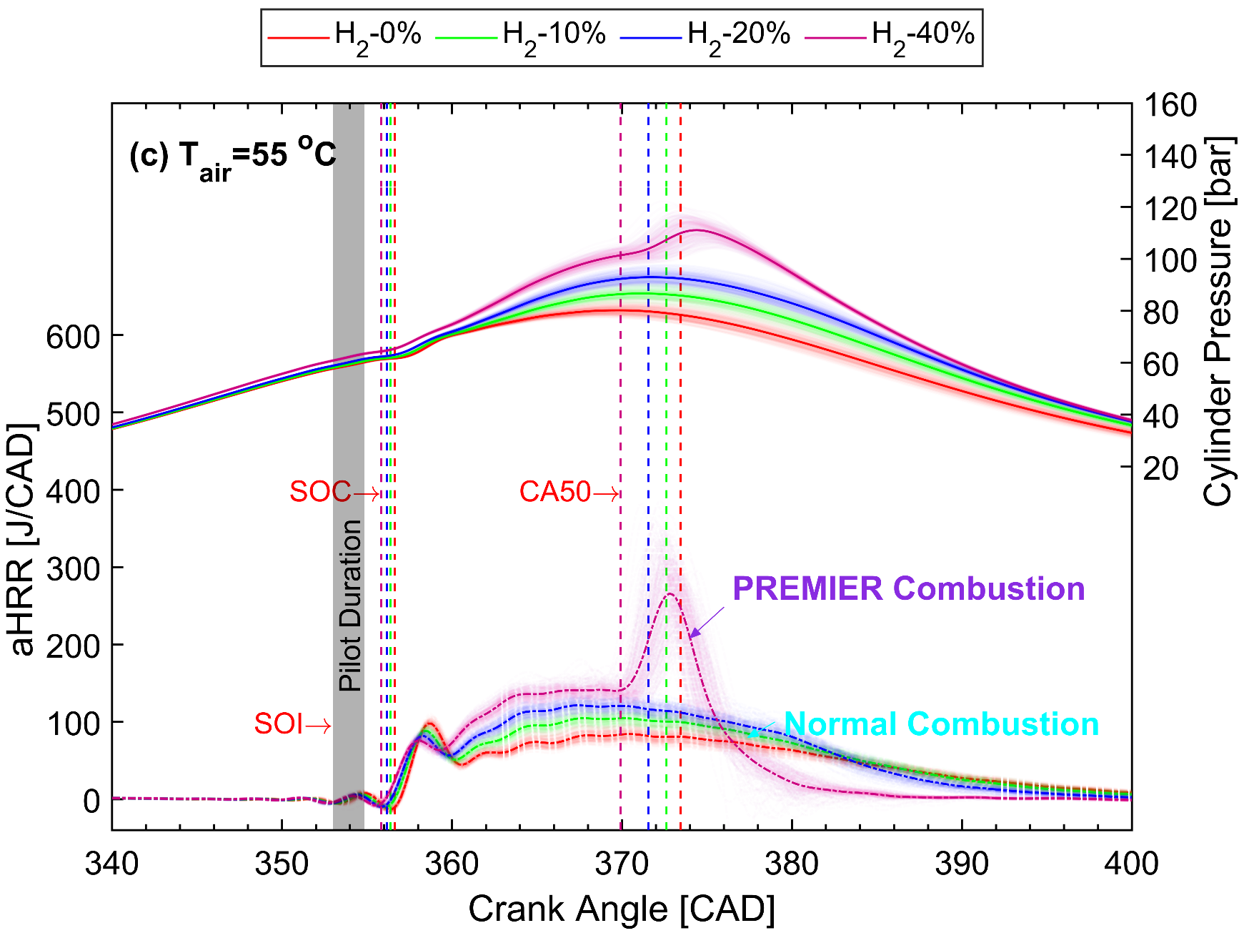
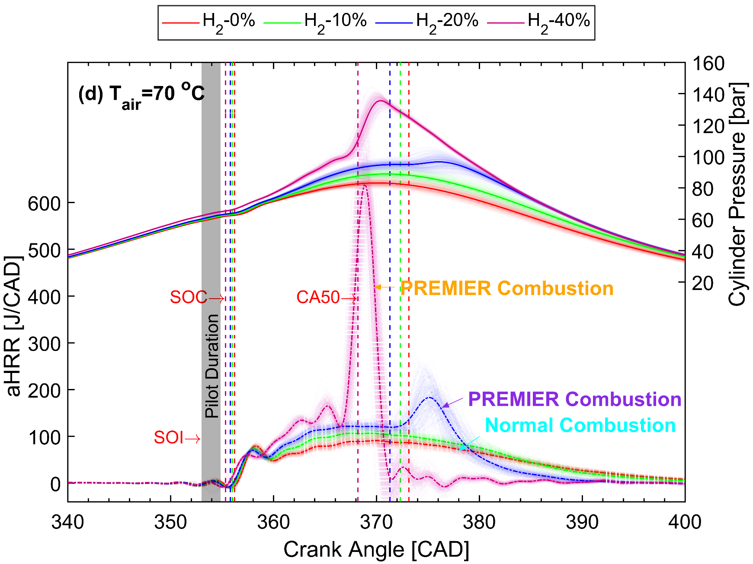
Research Group of Thermodynamics and Internal Combustion Engines
Department of Mechanical Engineering
Aalto University, Finland
Performance of a Single-Cylinder Compression Ignition Engine
Background
Data Acquisition and Postprocessing
Work Principle of CI Engine
Figure 1. Work process of a four-stroke engine: intake, compression, work and exhaust
Figure 3. Typical test bench of an internal combustion engine and cylinder pressure sensor
Engine modelling
Experimental Setup
Figure 4. Data postprocessing and results plotting
Objectives and Outcomes
Figure 2. The single-cylinder full-metal compression ignition engine at Aalto Engine Lab
You have an opportunity to operate a practical engine with various engine operating conditions.
You will learn how to use the second law of thermodynamics to analyze the engine performance based on the cylinder pressure, e.g., heat release rate, combustion efficiency, indicated thermal efficiency, etc.
You will learn Matlab programing to do post-processing and plot the results.
You will learn how do the injection timing, injection duration, injection pressure, equivalence ratio and fuel properties affect the engine performance.
After the project, you will gain more insight into the application of thermodynamics in an internal combustion engine.
Descriptions of the Engine
A special designed single-cylinder full-metal CI engine aims at investigating the engine performance by varying the different parameters. Compared to the commercial engines, this engine provides more flexible control.
Cylinder bore (mm) | 111
Stroke (mm) | 145
Total Displacement- 6-cylinder (L) | 8.42
Displacement 1-cylinder (L) | 1.4
Compression ratio | 16.5:1
Diesel pilot injection | Bosch CRIN3-20 Common rail, direct
Methane injection | Port injection with 2 Hana injectors
Engine control | Custom made in LabVIEW environment, uses NI DRIVVEN and other NI modules
eng.aalto.fi/en

